Slide 1

Data Collection – Group 10
Team Details:
Akshat Mathur (12010030)
Sandipto Sanyal (12010004)
Shivaji Paleti (12010072)
Sidharth Gupta (12010028)
Sushmita Sahu (12010027)

Slide 2
Contents
Introduction to Udaan Learning Portal
Problem Statement
Pipeline
Scraping Logic
Feature Engineering
EDA
Conclusion

Slide 3
Udaan Learning Portal -Sky is the limit
A brand-new professional training platform which will provide on demand, at home online video courses from thousands of experts in domains like IT, Photography, Music etc.
During the time of Covid, where people can’t physically attend classes and have a lot of time at hand to learn new skills or develop their existing talents and technologies.
A faster, cheaper and more efficient way to reinvent yourself.
Notes:
Inspired by our current inability to attend residencies, we came up with this idea!

Slide 4




Problem Statement
Problem Statement
Recommend popular and high rated courses for users
Recommendation Engine
To provide suggestions to trainers to release offering catering to a wider audience
Offering suggestion Model
To build a pricing Intelligence model for competitive pricing strategy
Competitive Dynamic Pricing

Slide 5
Pipeline
Scraping from Udemy.com
(Data Collection)
Raw Data
(Database)
Data preprocessing
(Data Cleaning, Derived Variables etc.)
Feature Creation & Selection
(Price, Category, Duration, Lectures, Rating etc.)
Preparing Dataset for ML Training
Platform for Students
Expose Model Through API
Recommendation Engine
Platform for Teachers
ML Model Training and Tuning
Expose Model Through API
Pricing Model
Notes:
What’s the o/p of your ML Algo-

Slide 6
Data Scraping Logic
No
Search item in course list?
Page scanned <= page count limit?
Declare user variables for courses list and page count limit
Open chrome browser through selenium
Search the site for courses relevant to the search item
Scroll the whole page to load price tags of courses
Yes
Yes
Get the XML of the page
start
No
End search and store result in dataframe
Go to the next page
Traverse XML tree to get the course details
stop
Data cleaning and EDA
Stop chrome driver
Link To Code

Slide 7
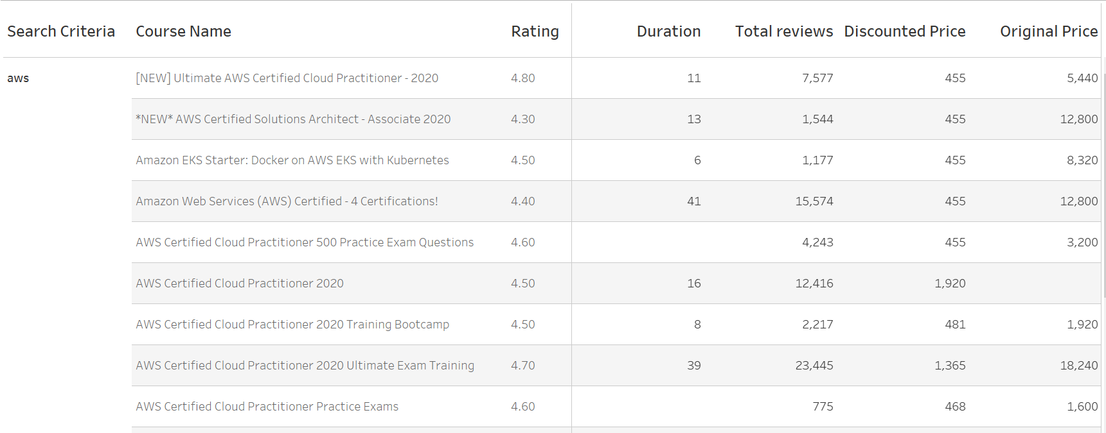
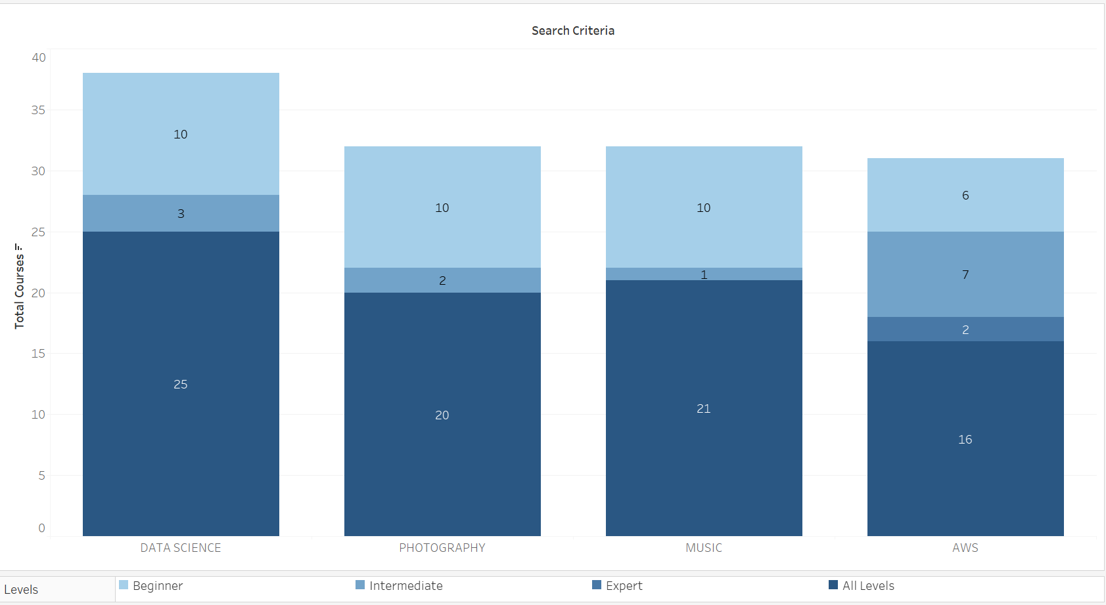
Feature Engineering
Search Criteria
Course Name
Course Description
Duration
Original Price
Discounted Price
Rating
Total Reviews

Slide 8
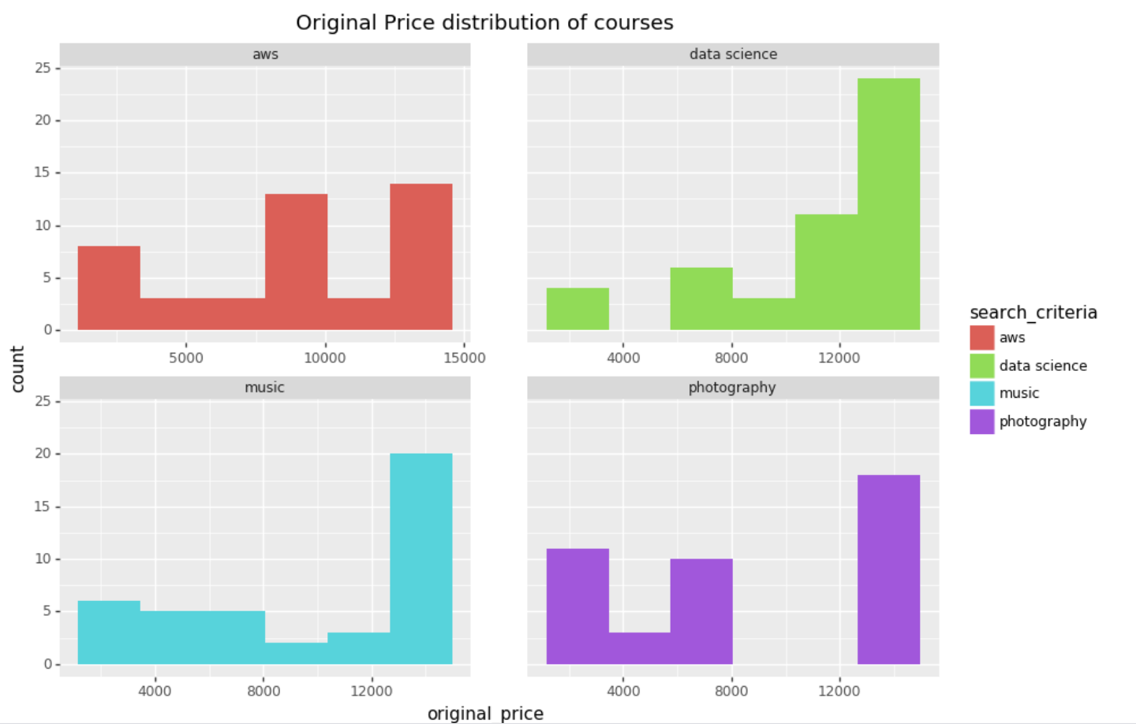
Exploratory Data Analysis
Original Price Distribution
Insights

Slide 9
Conclusion
Competitive Pricing
Future Releases – Improve recommendation Engine
Scalable Product
Add more categories – Like IT, Home Science etc
Expand – add User engagement

Slide 10
Thank You!

Slide 11
Appendix

Slide 12
Sushmita – Introduction and Problem Statement- Slide 3-4
Shivaji- Slide 5
Sandipto – Data Flow Logic/Code – Slide 6
Sid – Slide 7-8
Akshat – Slide 9

Slide 13
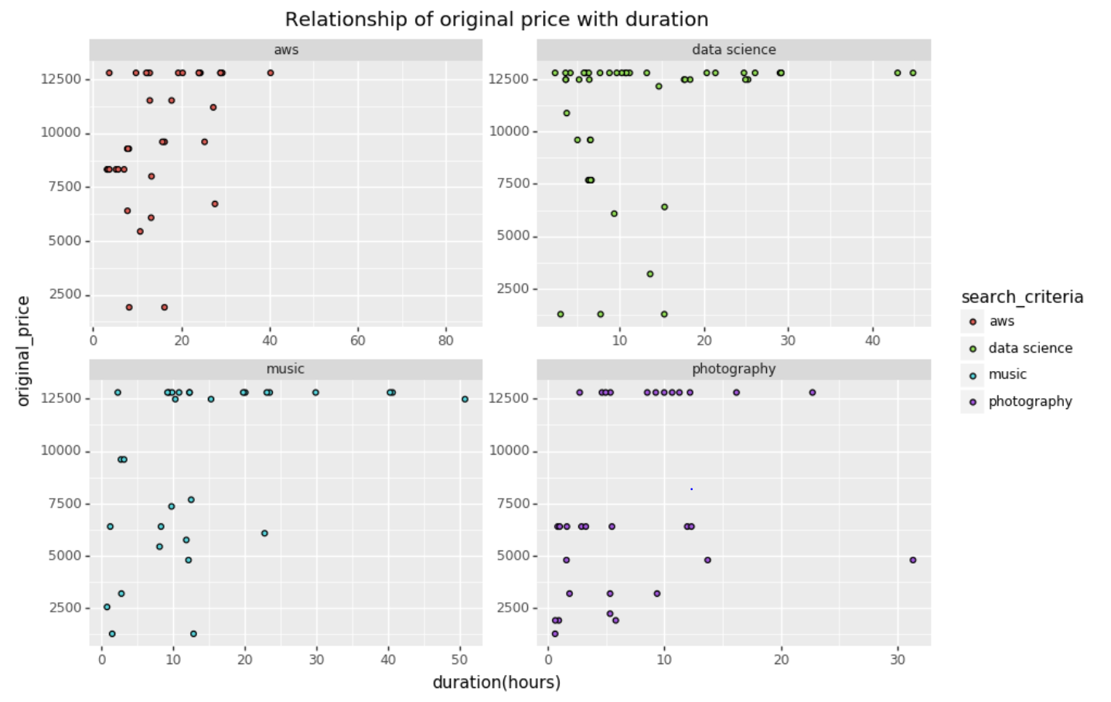
Exploratory Data Analysis Cont’d
Original Price vs Duration
Insights

Slide 14
Exploratory Data Analysis
Insights

